Slide 1
Home
Notes:
image
No alt text provided
image
No alt text provided
textbox
No alt text provided
textbox
No alt text provided
slicer
No alt text provided
slicer
No alt text provided
shape
No alt text provided

Slide 2
Bilan Mois
Notes:
slicer
No alt text provided
card
No alt text provided
card
No alt text provided
textbox
No alt text provided
image
No alt text provided
slicer
No alt text provided
textbox
No alt text provided
textbox
No alt text provided
Evolution des arrivées aux PF par principale Nationalité
No alt text provided
Evolution des arrivées aux PF par principal point d'entrée
No alt text provided
tableEx
No alt text provided
tableEx
No alt text provided
textbox
No alt text provided
textbox
No alt text provided
shape
No alt text provided
textbox
No alt text provided
textbox
No alt text provided

Slide 3
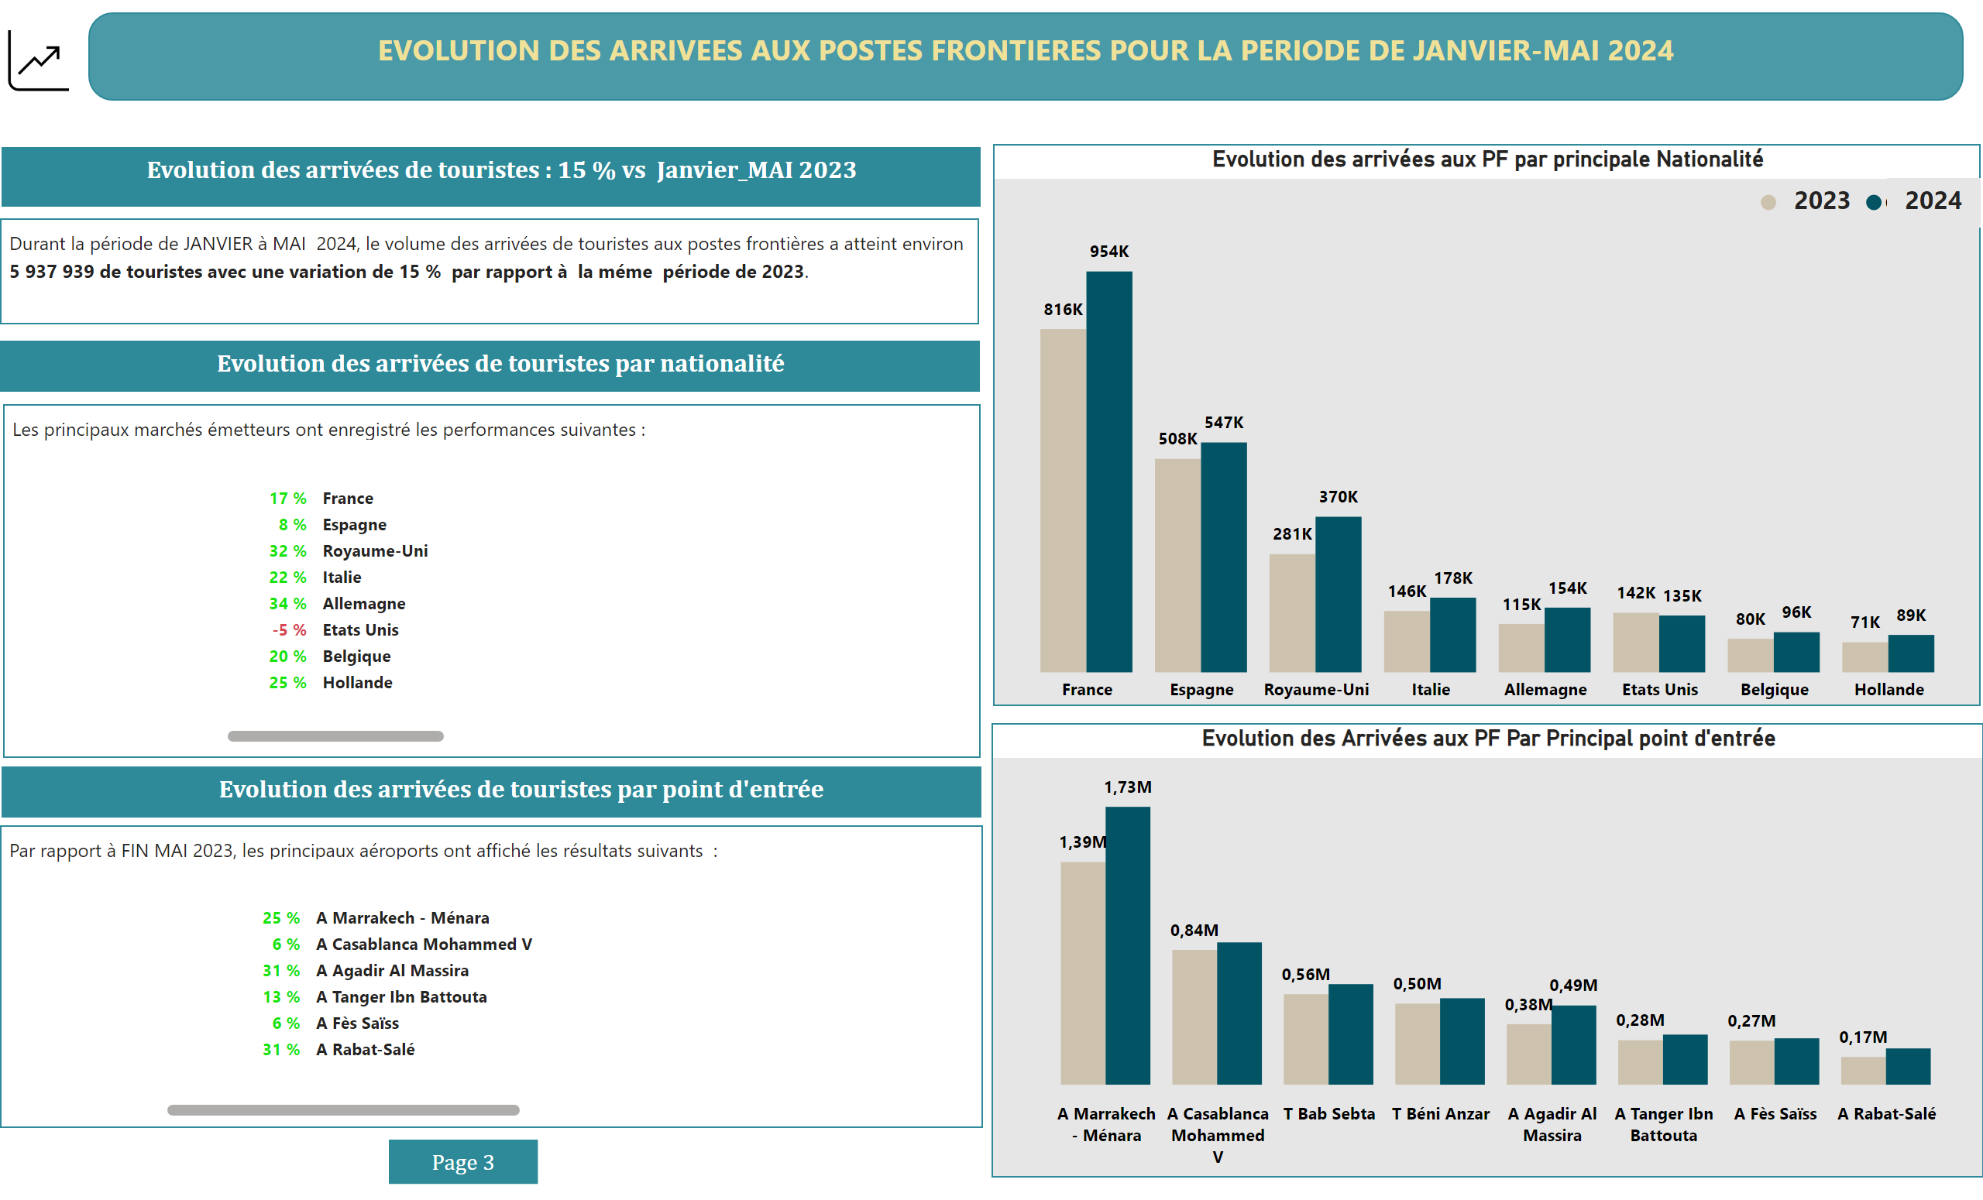
Bilan Cumul
Notes:
slicer
No alt text provided
card
No alt text provided
card
No alt text provided
textbox
No alt text provided
image
No alt text provided
slicer
No alt text provided
textbox
No alt text provided
textbox
No alt text provided
textbox
No alt text provided
textbox
No alt text provided
Evolution des arrivées aux PF par principale Nationalité
No alt text provided
Evolution des Arrivées aux PF Par Principal point d'entrée
No alt text provided
tableEx
No alt text provided
tableEx
No alt text provided
textbox
No alt text provided
textbox
No alt text provided
shape
No alt text provided

Slide 4
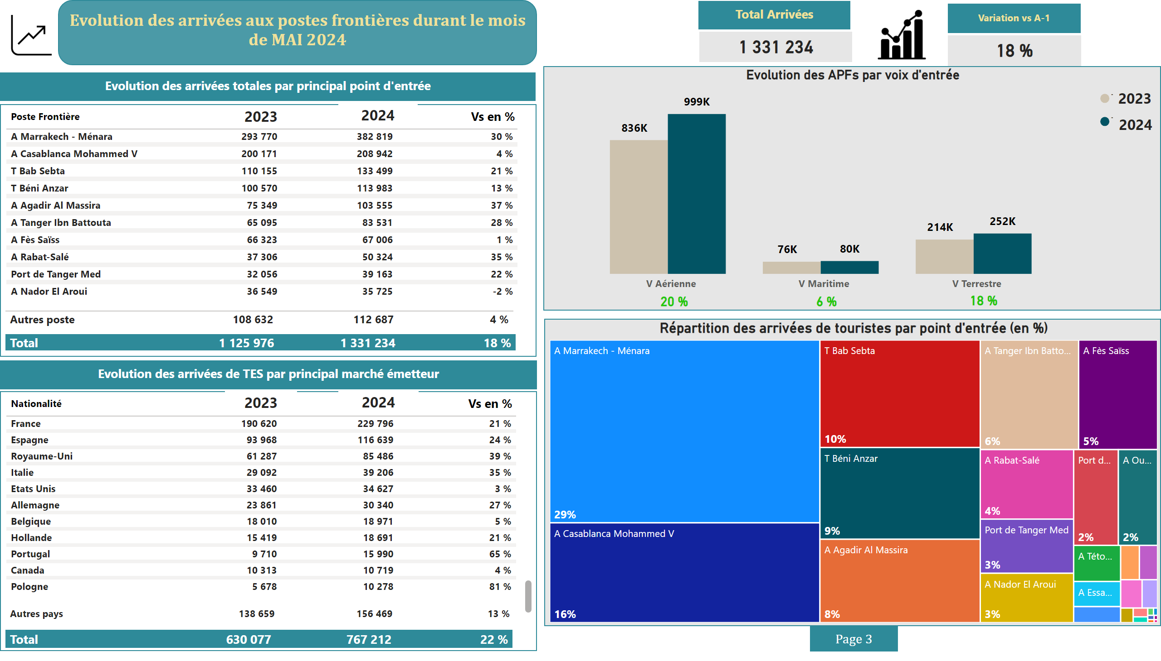
APF Mois
Notes:
card
No alt text provided
card
No alt text provided
card
No alt text provided
tableEx
No alt text provided
card
No alt text provided
shape
No alt text provided
tableEx
No alt text provided
shape
No alt text provided
tableEx
No alt text provided
tableEx
No alt text provided
shape
No alt text provided
slicer
No alt text provided
tableEx
No alt text provided
tableEx
No alt text provided
slicer
No alt text provided
textbox
No alt text provided
Evolution des APFs par voix d'entrée
No alt text provided
Répartition des arrivées de touristes par point d'entrée (en %)
No alt text provided
card
No alt text provided
card
No alt text provided
card
No alt text provided
card
No alt text provided
shape
No alt text provided
shape
No alt text provided
card
No alt text provided
textbox
No alt text provided
textbox
No alt text provided
image
No alt text provided
shape
No alt text provided
card
No alt text provided
textbox
No alt text provided
image
No alt text provided
textbox
No alt text provided
card
No alt text provided

Slide 5
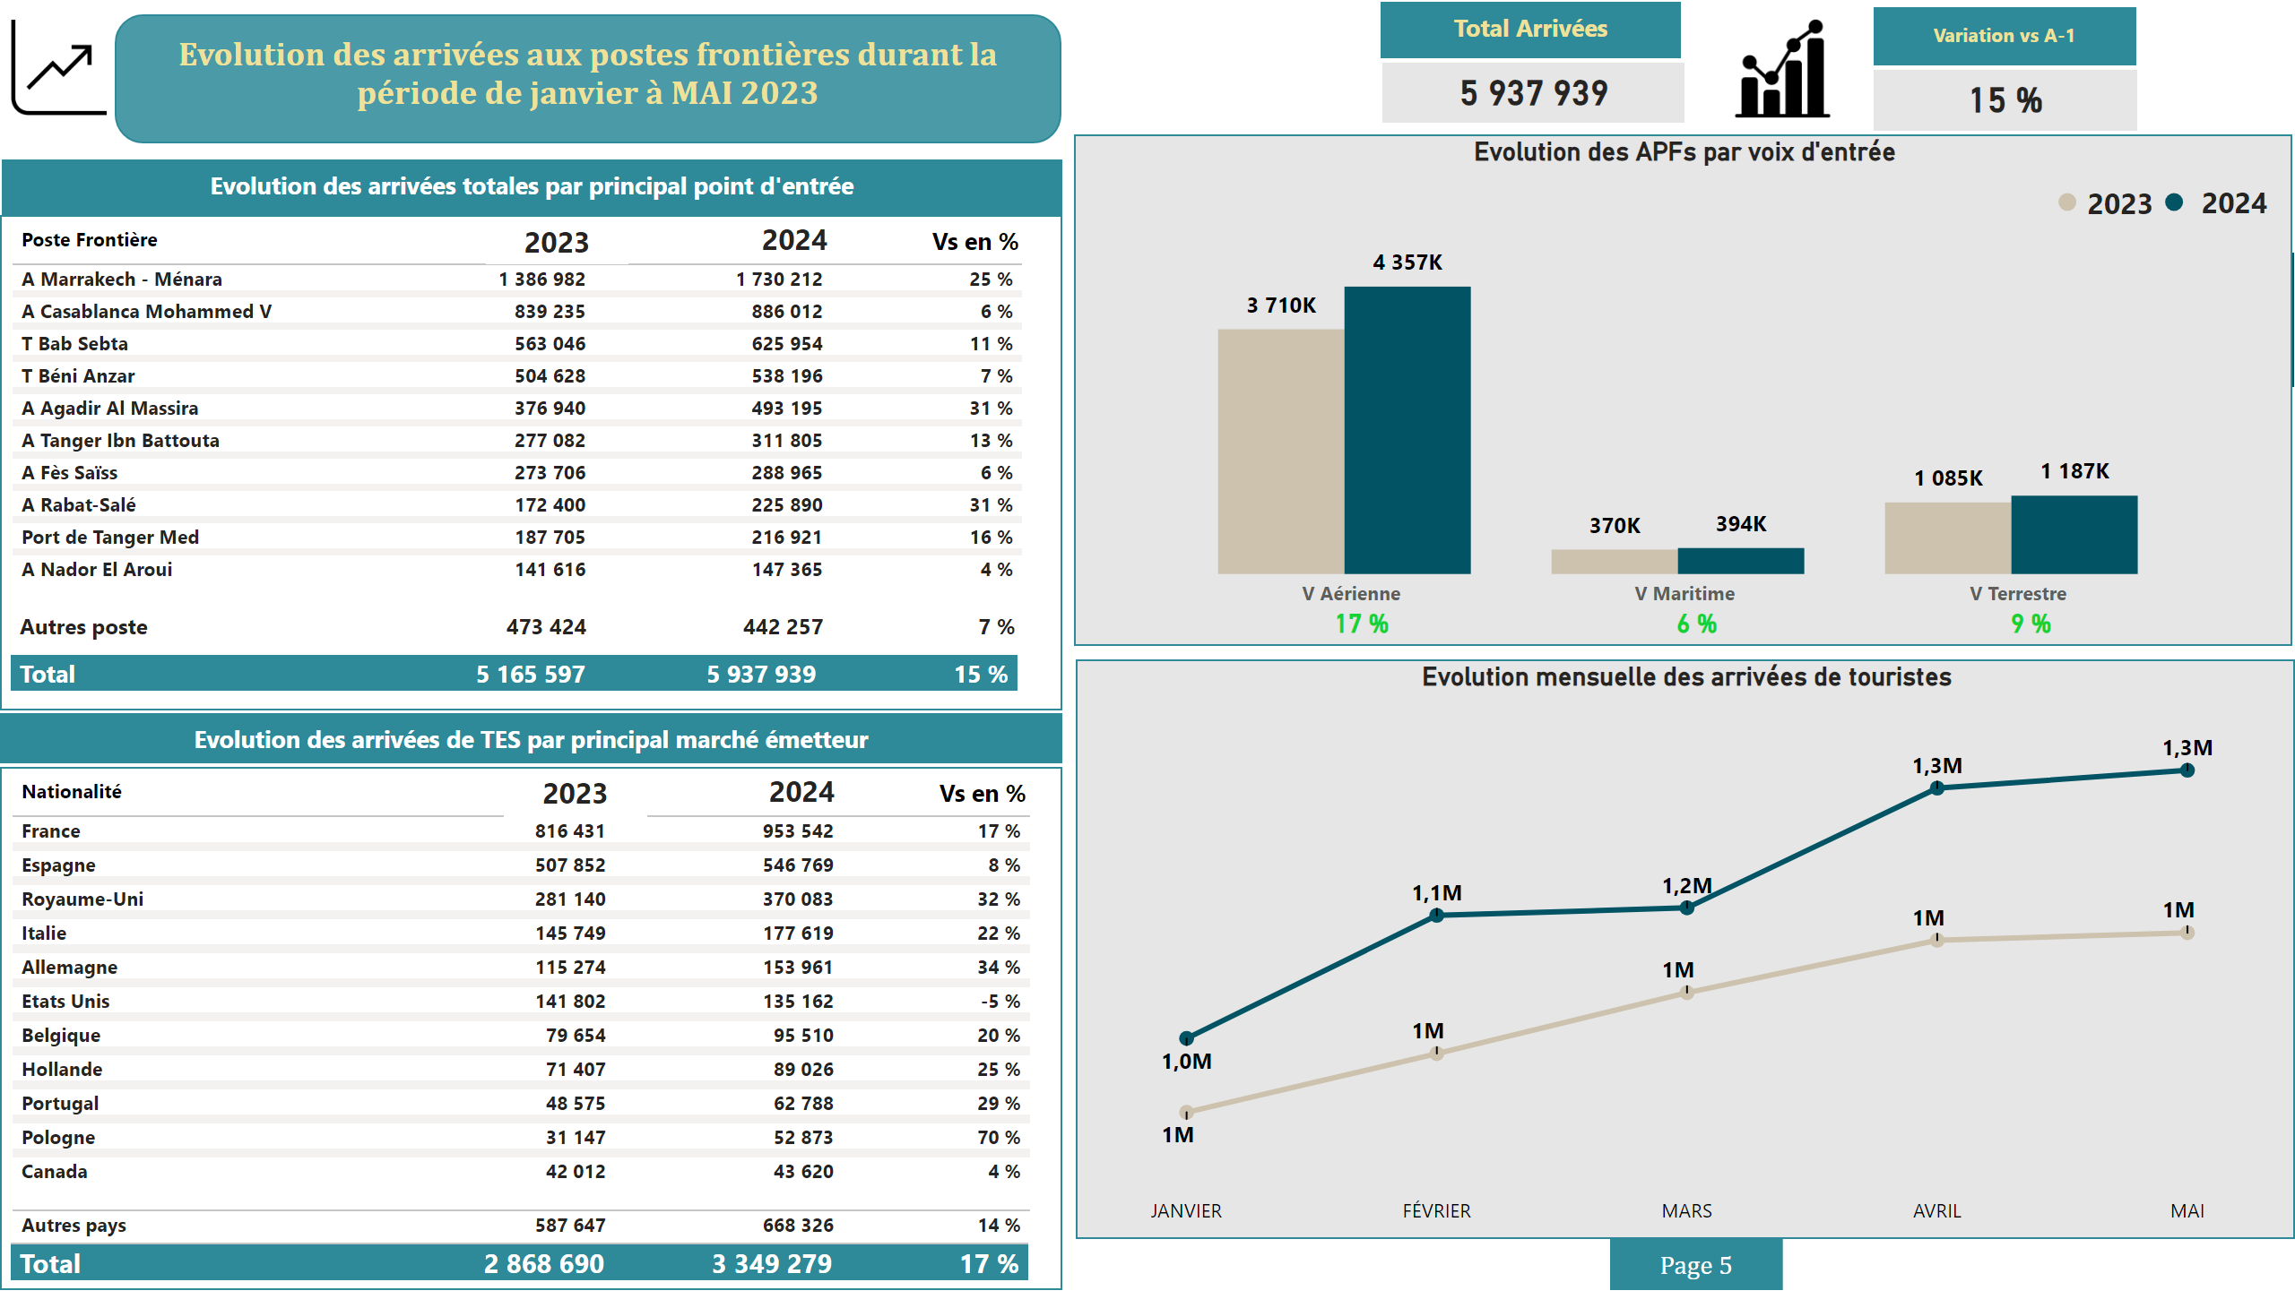
APF Cumul
Notes:
card
No alt text provided
card
No alt text provided
card
No alt text provided
tableEx
No alt text provided
tableEx
No alt text provided
shape
No alt text provided
tableEx
No alt text provided
tableEx
No alt text provided
shape
No alt text provided
card
No alt text provided
card
No alt text provided
shape
No alt text provided
shape
No alt text provided
slicer
No alt text provided
tableEx
No alt text provided
tableEx
No alt text provided
Evolution des APFs par voix d'entrée
No alt text provided
Evolution mensuelle des arrivées de touristes
No alt text provided
card
No alt text provided
card
No alt text provided
card
No alt text provided
shape
No alt text provided
card
No alt text provided
shape
No alt text provided
card
No alt text provided
card
No alt text provided
textbox
No alt text provided
textbox
No alt text provided
shape
No alt text provided
shape
No alt text provided
shape
No alt text provided
slicer
No alt text provided
image
No alt text provided
textbox
No alt text provided
shape
No alt text provided
textbox
No alt text provided
card
No alt text provided
image
No alt text provided
textbox
No alt text provided
card
No alt text provided

